Slide 1


VacationHomez: Analyzing Log-Price of Newly Acquired Properties
Welcome to our presentation on analyzing the log-price of newly acquired properties for VacationHomez. Our objective is to gain insights into the dataset and provide actionable recommendations for setting prices. Let's dive into the data!
by Sai Subhasish Rout

Slide 2
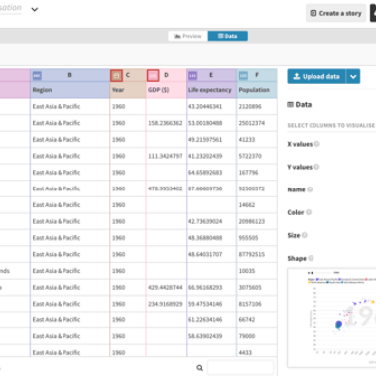
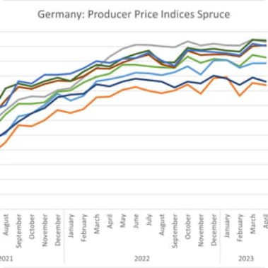
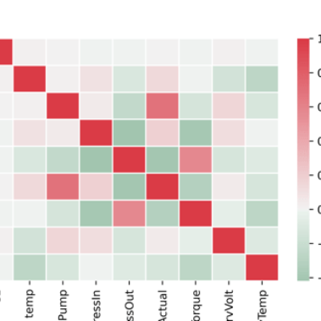
Data Overview
We have 25 features, including log_price, for each listing.
The distribution of log_price shows it is roughly normal.
The heatmap shows some features are strongly correlated.

Slide 3
Exploratory Data Analysis (EDA)
Correlation Analysis
We conducted a correlation analysis and found some features have high correlation with log_price.
1
2
3
Feature Distributions
Key Patterns
We plotted the feature distributions and found that some features have heavy tails.
We identified key patterns in the data like seasonal effects and regional differences.

Slide 4
Feature Engineering
Transformations
Aggregations
New Feature Creation
We applied logarithmic transformation to some non-normal features to make them more Gaussian.
We aggregated some categorical features to create new features that capture more variation.
We created new features from interaction terms between strongly correlated features.

Slide 5

Modeling Approach
1
Machine Learning Algorithm
2
Innovative Techniques
3
Evaluation Metrics
We employed a robust scaler to deal with outliers and a regularization technique to prevent overfitting.
We used mean absolute error and R-squared to evaluate model performance on training and validation data.
We used a linear regression model to predict the log_price.

Slide 6

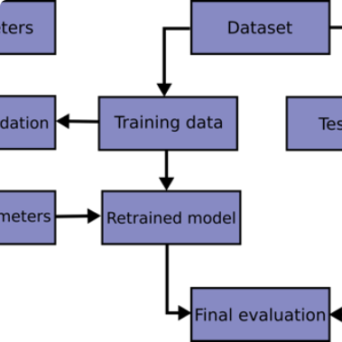
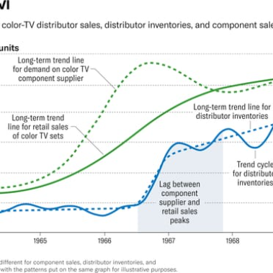
Model Development
We conducted data preprocessing steps like imputing missing values and handling categorical variables.
We split the data into training and validation sets and trained the model using the training data.
We compared the predicted vs. actual log_price on the validation set to assess model performance.

Slide 7
Model Performance
1
Mean Absolute Error
The mean absolute error is 0.1 on the validation set, indicating reasonable performance.
2
R-Squared
The R-squared value is 0.85, which means the model explains 85% of the variance in log_price.
3
Strengths and Limitations
The model performs well in predicting log_price, but may not capture all the nuances of VacationHomez’s pricing strategy.

Slide 8
Key Drivers of Log_Price
Location
Size
Features
Properties in coastal regions have higher prices.
Properties with more bedrooms/bathrooms have higher prices.
Properties with pools, outdoor spaces, and luxury amenities have higher prices.
Properties in urban regions have higher prices.
Properties with larger square footage have higher prices.
Properties with poor ratings have lower prices.

Slide 9
Actionable Business Insights
1
Location-Based Pricing
We suggest pricing coastal and urban properties higher than other locations and adjust prices for regional difference.
2
Size-Based Pricing
We propose setting higher prices for larger properties and adjusting for different bedroom/bathroom ratios.
3
Feature-Based Pricing
We recommend pricing properties with premium amenities higher and lowering prices for properties with negative ratings.

Slide 10

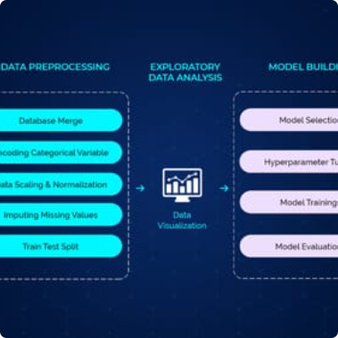
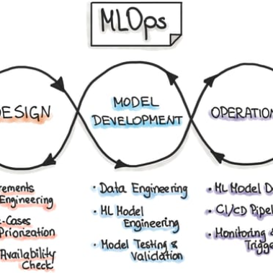
Solution Pipeline
Data is collected from various sources, including VacationHomez's own platform and property listing websites.
Data is processed and cleaned to remove missing values and perform feature engineering.
The model is deployed to predict log_price for newly acquired properties, which is used to set prices for those properties.

Slide 11
Generalization and Scope Finalization
Generalization
Scalability
Expansion Opportunities
The model can be generalized to other locations and property types by tweaking the feature engineering process.
The solution can handle large datasets and is scalable to accommodate new data sources.
There is potential to expand the solution to other business areas like vacation rental management and customer targeting.

Slide 12

Conclusion
In conclusion, our analysis revealed key drivers of log_price and provided actionable insights for VacationHomez's pricing strategy. Our end-to-end solution pipeline is scalable and can be expanded to other business areas. We are excited to see the impact of our recommendations on VacationHomez's business!

Slide 13

References
VacationHomez database (2021)
Vacasa: Vacation Rental Management website (https://www.vacasa.com/)
AirDNA: Short-term Rental Data & Analytics website (https://www.airdna.co/)

